Slide 1
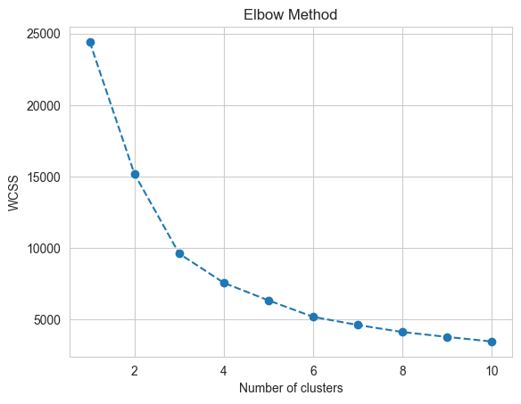
Clustering Evaluation – Elbow plots

Slide 2
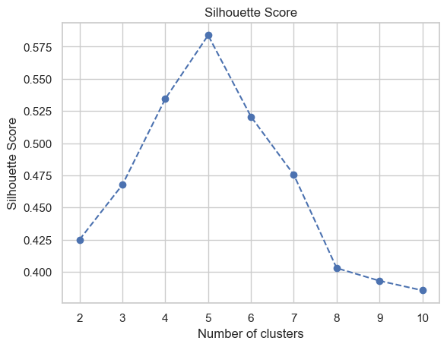
Clustering Evaluation – Silhouette score

Slide 3
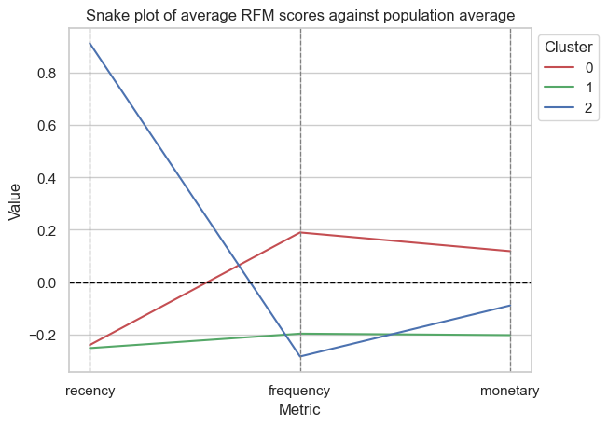
3 Clusters

Slide 4
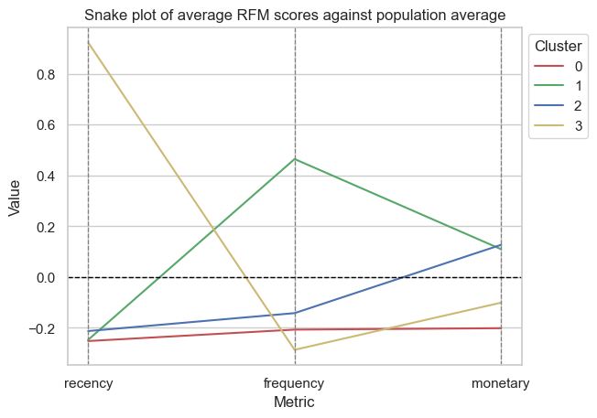
4 Clusters
Only 1 segment of customer (cluster 1) that spends more frequently on average.
This same customer segment has a higher monetary spend compared to the population average as with cluster 2.
Cluster 0 are low spenders who shop infrequently, less recently and lower average spend compared to the population average.
Cluster 3 segment of customers – spent very recently i.e. towards end of the year but less frequently overall and with lower average spend.

Slide 5
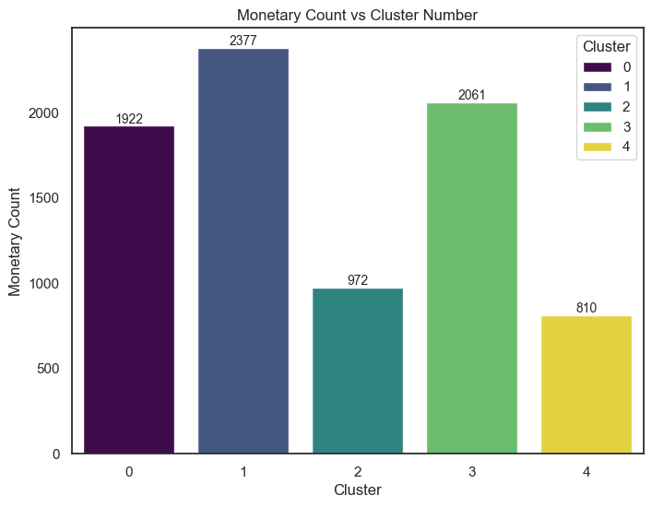
5 Clusters
Most individuals in core clusters 0, 2 and 3.
Minor clusters in 2 and 4.
2 core clusters and 2 minor clusters.

Slide 6
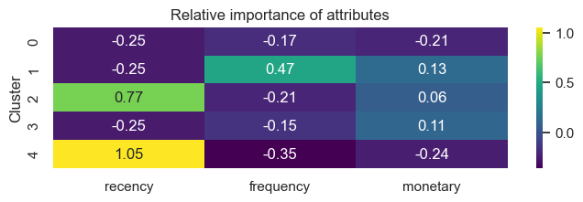
5 Clusters
Low spread around monetary spend.
Many customers are relatively infrequent spenders with one cluster where frequency of transactions is high.
2 Clusters with highly above average recency – spending very close up until the end of the year.

Slide 7
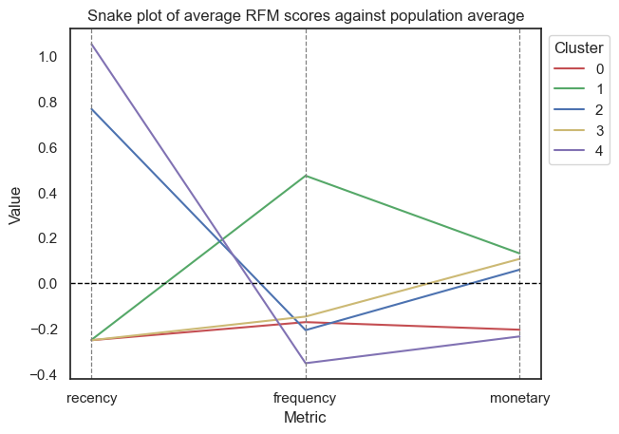
5 Clusters
Major clusters (0,1,3)
0: Below average on all metrics.
1: Above average frequency and monetary spend, low recency.
3: Below average recency and frequency and average/slightly above average monetary spend.
Very large group of people.
Minor clusters (2,4)
2: Below-average frequency, average monetary spend and high recency.
4: Below average frequency, average monetary spend but low recency.
Minor clusters are quite similar apart from the fact that they differ on how recently they have made transactions.

Slide 8
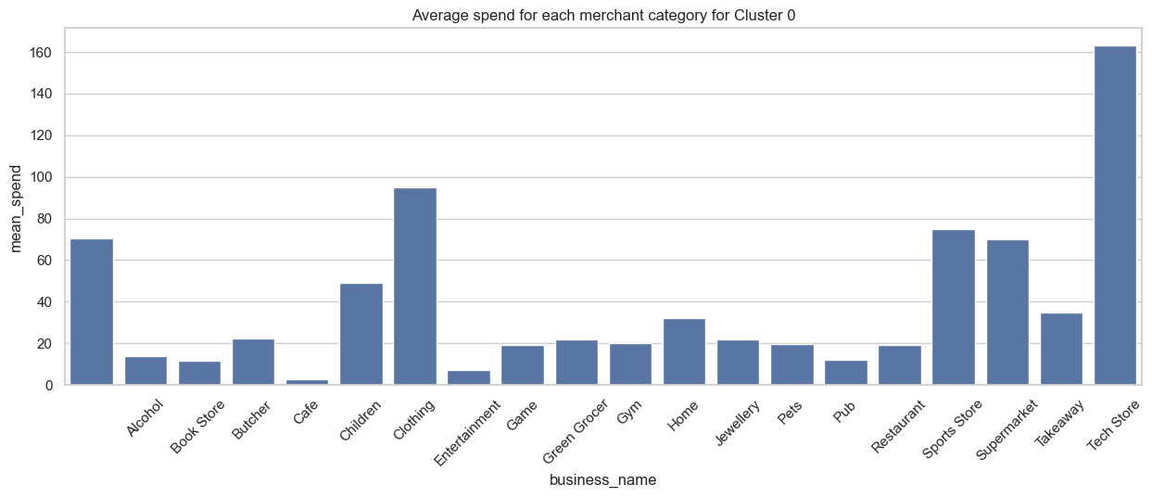
Spending behaviours for each customer segment

Slide 9
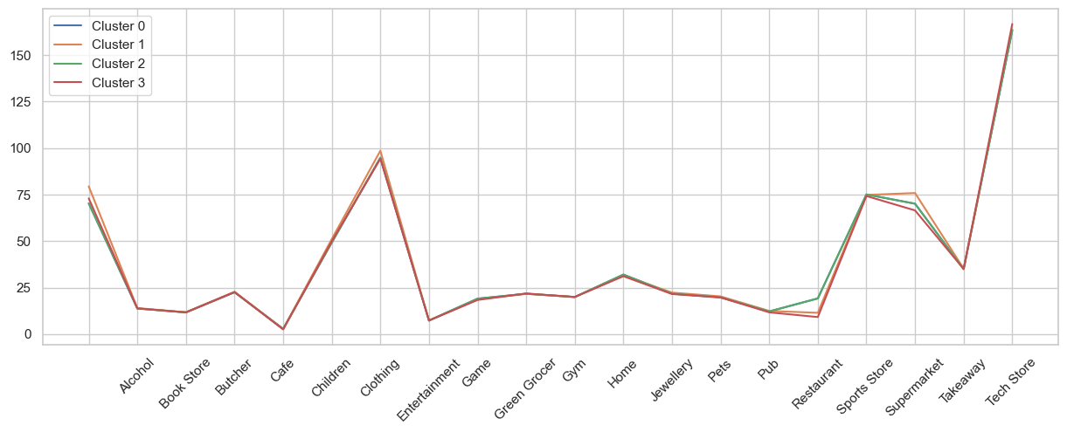
Spending behaviours for each customer segment – 4 clusters

Slide 10
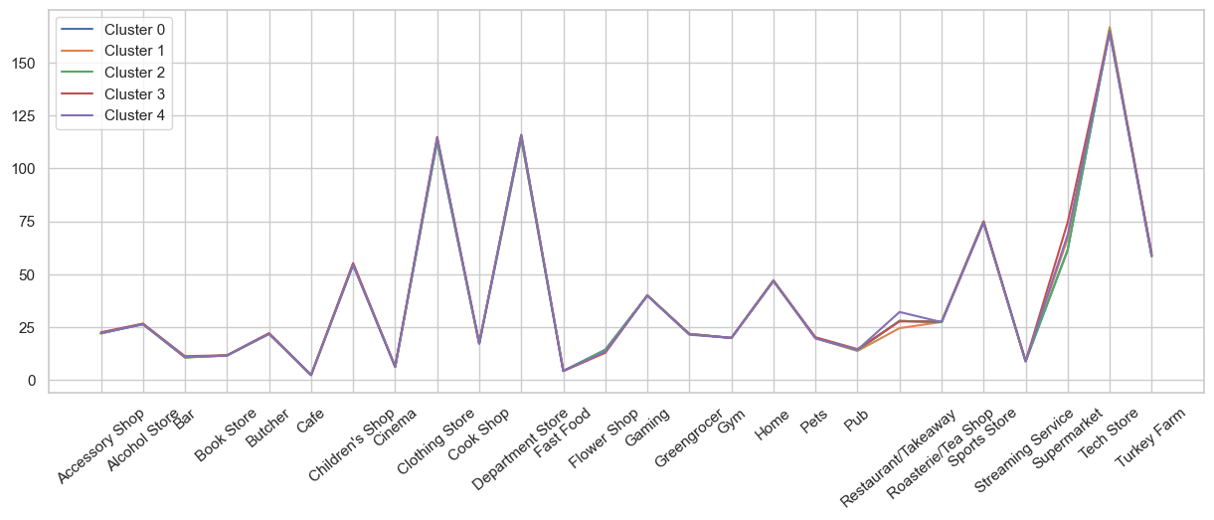
Spending behaviours for each customer segment – 5 clusters

